Slide 1
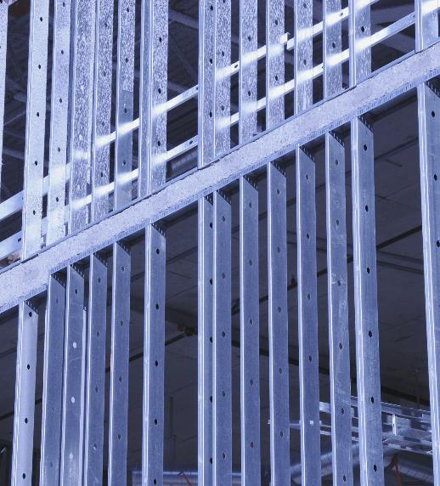
Facility Systems
An in-depth overview of infrastructure management
Notes:
AI-generated content may be incorrect. ---

Slide 2
Introduction to Facility Systems
Notes:
Role and Importance of Facility Systems, Overview of Major Facility Systems

Slide 3
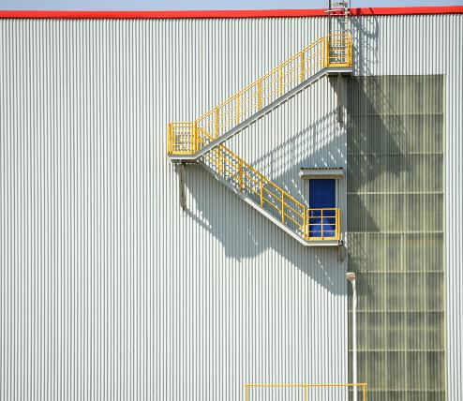
Role and Importance of Facility Systems
The facilities planner must be aware that
1. The cost of constructing, operating, and maintaining a facility is significantly impacted by the facility systems.
2. A critical factor affecting facility flexibility is the facility’s systems.
3. A facility plan is not complete until all systems are specified.
4. Facility systems have an important impact on employee performance, morale, and safety.
5. Facility systems have an important impact on the fire protection, maintenance, and security of a facility.
Notes:
Facility systems are integral to the planning and operation of any industrial or commercial building. While the facilities planner may not design every system in detail, they are responsible for specifying what systems are required, where they should be located, and how they integrate into the overall facility layout. These systems significantly influence the cost of construction, operation, and maintenance, making them a critical factor in long-term financial planning. Additionally, facility systems determine the flexibility of a building, allowing for future modifications without major disruptions. A facility plan is incomplete until all systems are specified, as they impact employee performance, morale, and safety. For example, inadequate HVAC systems can lead to discomfort and reduced productivity, while poor lighting can cause eye strain and accidents. Furthermore, systems such as fire protection and security are essential for compliance with safety regulations and for safeguarding assets. In summary, facility systems are not just technical components; they are strategic elements that affect operational efficiency, sustainability, and the overall success of the organization.

Slide 4
Overview of Major Facility Systems
System | Primary Function | Impact
Structural | Load-bearing framework | Safety, durability
Atmospheric (HVAC) | Temperature & air quality control | Comfort, health
Enclosure | Barrier against climate & intrusion | Energy efficiency
Lighting & Electrical | Illumination & power distribution | Productivity, safety
Life Safety | Fire protection & emergency response | Compliance, occupant safety
Sanitation | Water supply & waste management | Hygiene
BAS | Centralized building control | Operational efficiency
CMMS | Maintenance planning | Asset reliability
Notes:
There are eight major facility systems that planners must consider: structural systems, atmospheric systems (HVAC), enclosure systems, lighting and electrical systems, life safety systems, sanitation systems, building automation systems (BAS), and computerized maintenance management systems (CMMS). Structural systems provide the physical framework and load-bearing capacity of the building. Atmospheric systems regulate temperature, humidity, and air quality to ensure occupant comfort and equipment functionality. Enclosure systems, including walls, floors, and roofs, act as barriers against environmental elements and contribute to thermal performance. Lighting and electrical systems ensure adequate illumination and power distribution, which are vital for productivity and safety. Life safety systems encompass fire alarms, sprinklers, and emergency exits, protecting occupants during emergencies. Sanitation systems manage water supply and waste disposal, maintaining hygiene standards. BAS integrates various building functions for centralized control, improving efficiency and reducing energy consumption. CMMS supports maintenance planning and asset management, ensuring reliability and minimizing downtime. Together, these systems form the backbone of a well-functioning facility.

Slide 5
9.3 Enclosure Systems
Notes:
Purpose and Components of Enclosure Systems, Thermal Performance and Solar Gain Control

Slide 6
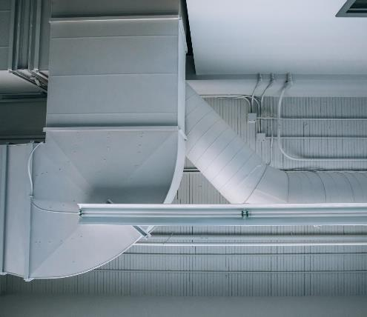
Purpose and Components of Enclosure Systems
Protective Barrier Functions
Enclosure systems protect buildings from extreme weather, moisture, and pests while enhancing occupant security and comfort.
Core Enclosure Components
Floors, walls, and roofs form the primary components designed to maintain comfort and regulate thermal performance within buildings.
Thermal Performance Impact
Proper insulation in enclosure systems reduces heat loss, decreases HVAC load, lowers energy costs, and improves sustainability.
Doors and Windows Role
Doors and windows regulate access, ventilation, light transmission, privacy, and acoustic control in enclosure systems.
Notes:
Enclosure systems serve as protective barriers against external environmental factors such as extreme temperatures, wind, moisture, and unwanted entry by humans or pests. They also regulate ventilation, natural lighting, and sound transmission, contributing to occupant comfort and security. The primary components of an enclosure system are floors, walls, and roofs, each designed to maintain a specified comfort level within the facility. These elements influence thermal performance, which is often underestimated, leading to over-reliance on HVAC systems. For instance, poorly insulated walls can result in significant heat loss during winter, increasing energy consumption for heating. Conversely, effective enclosure design can reduce HVAC loads, lower operational costs, and enhance sustainability. Doors and windows act as filters, controlling access, ventilation, and light transmission while maintaining privacy and acoustic control. In modern facilities, enclosure systems are designed to balance conflicting influences such as aesthetics, cost, and energy efficiency, ensuring optimal performance across all parameters.

Slide 7
Better Enclosure → Less Energy Needed → Higher Occupant Comfort
The enclosure system (floors, walls, roof) provides protection against: Extreme temperatures Wind loads Water & moisture Unwanted entry (human/insects) It also controls: Ventilation Natural lighting Sound Security Key Insight Most buildings incorrectly rely too heavily on HVAC systems while underestimating the thermal role of the building envelope. General Principle:

Slide 8
Thermal Performance and Solar Gain Control
Glazing Type | Solar Transmission (%)
Single Glazing | 90%
Double Pane + Heat Absorbing | 45%
Double Pane + Reflective Glass | 25%
Notes:
Thermal performance addresses the imbalance of heat transmission between indoor and outdoor environments, primarily influenced by climate and temperature differentials. Effective thermal design reduces reliance on artificial heating and cooling systems, thereby improving energy efficiency. One critical aspect of thermal performance is managing solar gain. Uncontrolled solar radiation can lead to overheating, increasing cooling loads and energy costs. Various glazing configurations can mitigate this issue. For example, single-glazed windows transmit approximately 90% of incident solar rays, offering minimal thermal resistance. Introducing a double-pane configuration with a heat-absorbing layer reduces transmission to about 45%, while substituting the heat-absorbing layer with reflective glass further lowers transmission to approximately 25%. These improvements not only enhance occupant comfort but also contribute to sustainability goals by reducing HVAC energy consumption. Incorporating shading devices, reflective coatings, and advanced insulation materials are additional strategies to optimize thermal performance in enclosure systems.

Slide 9
Atmospheric Systems (HVAC)
Notes:
Functions and Comfort Variables, Indoor Air Quality and Ventilation Standards

Slide 10
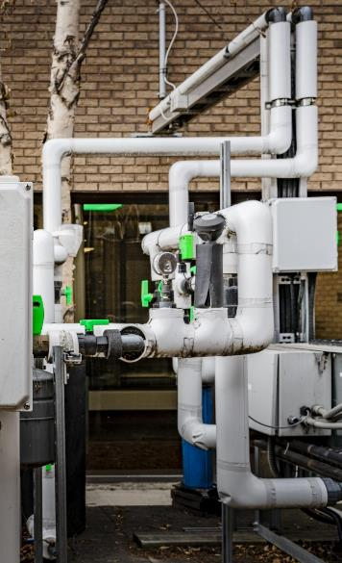
Functions and Comfort Variables
HVAC System Functions
HVAC systems regulate indoor temperature, humidity, and air quality to maintain comfort and equipment functionality.
Human Comfort Variables
Human comfort depends on temperature, humidity, clothing, and metabolic activity with HVAC controlling the first two actively.
Application in Facilities
Healthcare facilities control humidity near 50% to inhibit pathogens; offices focus on temperature stability for productivity.
Air Speed Management
HVAC systems maintain low air speed indoors to prevent discomfort while ensuring effective ventilation.
Notes:
Atmospheric systems, commonly referred to as HVAC systems, are designed to maintain indoor environmental conditions that support human comfort and equipment functionality. These systems regulate temperature, humidity, and air quality, ensuring a healthy and productive work environment. The concept of human comfort was formalized in the 1960s through research at Kansas State University, which identified four key variables: temperature, humidity, clothing, and metabolic activity. While clothing and metabolic activity are generally assumed constant, HVAC systems actively control temperature and humidity. For example, healthcare facilities maintain humidity levels near 50% to inhibit bacterial and viral growth, whereas office environments prioritize temperature stability to enhance productivity. Atmospheric systems also address air speed, which is kept low to avoid discomfort. By integrating these parameters, HVAC systems create a balanced indoor climate that meets both regulatory standards and occupant expectations.

Slide 11
Indoor Air Quality and Ventilation Standards
Building Type | ACH Requirement
Office | 4
School | 9
Hospital | 13
Laboratory | 8
Animal Laboratory | 20
Notes:
Indoor air quality (IAQ) is a critical component of atmospheric systems, influencing health, comfort, and safety. Common pollutants include odors, particulate matter, and chemical contaminants such as radon gas, which can seep into buildings from soil and groundwater. Effective IAQ management involves source control, filtration, and ventilation. Ventilation dilutes indoor pollutants by introducing fresh outdoor air and exhausting stale air, a process quantified by air changes per hour (ACH). Local building codes stipulate minimum ACH values based on occupancy type. For instance, offices typically require 4 ACH, schools 9 ACH, hospitals 13 ACH, laboratories 8 ACH, and animal labs up to 20 ACH. Higher ACH rates necessitate larger HVAC equipment and ductwork, impacting space allocation and design. Proper ventilation not only removes contaminants but also regulates humidity and temperature, contributing to overall occupant well-being and compliance with health standards.

Slide 12
Sizing Atmospheric System Components
Notes:
Equipment Rooms and Space Allocation, Duct and Louver Sizing Guidelines

Slide 13
Equipment Rooms and Space Allocation
Facility Type | Equipment Room Size (% of Floor Area)
Office/Industrial | 5–7%
Hospital | 25%
Laboratory | 25–50%
Animal Laboratory | 50%
Notes:
The size of equipment rooms for HVAC systems depends on the air handling requirements, which correlate with the building's air change rate. As ACH increases, the space needed for air handling equipment also grows. For example, office and industrial buildings typically allocate 5–7% of floor area for equipment rooms, while hospitals require approximately 25%. Laboratories and animal facilities may need 25–50% and up to 50% respectively, due to their high ventilation demands. Proper space planning ensures that HVAC equipment operates efficiently without compromising usable floor space. Designers must also consider accessibility for maintenance and future upgrades, as inadequate space can lead to operational inefficiencies and increased costs.

Slide 14
Duct and Louver Sizing Guidelines
Component | Recommended Air Speed (ft/min)
Main Duct | 1800
Branch Duct | 900–1100
Intake Louver | 1000
Exhaust Louver | 2000
Notes:
Duct and louver sizing is essential for maintaining proper airflow and ventilation efficiency. Recommended air speeds for ducts are approximately 1800 feet per minute for main ducts and 900–1100 feet per minute for branch ducts. Louvers, which facilitate air intake and exhaust, have different speed requirements: intake louvers should operate at around 1000 feet per minute, while exhaust louvers can handle up to 2000 feet per minute. These specifications ensure optimal air distribution without causing excessive noise or energy consumption. Incorrect sizing can lead to pressure imbalances, reduced system performance, and increased operational costs. Therefore, accurate calculations based on airflow requirements and building codes are critical during the design phase.

